Slide 1
Simultaneous foothold and body optimization
05-08-2021
Ashutosh Gupta

Slide 2
Structure of the session
Introduction to Legged locomotion
Some basic Physics
Previous approaches
This paper’s approach
A bit discussion
Further developments

Slide 3
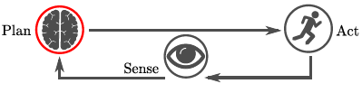
Introduction to Legged locomotion
Advantages of Legged robots
Discrete point path
Unstructured terrain
Sense - State estimation and perceive environment
Act - Plan the motion and execute
(Re-) Plan - Optimization based on robot dynamics (MPC)

Slide 4
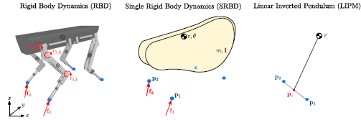
Some basic Physics
Rigid Body Dynamics (RBD)
A1 - Bodies don’t deform
Single Rigid Body Dynamics (SRBD)
A2 - Momentum by joint velocities is negligible
A3 - Full body inertia remains similar to one in nominal joint position
Linear Inverted Pendulum Model (LIPM)
A4 - CoM height is constant
A5 - Angular velocity and acceleration of base are zero
A6 - Footholds are at constant height

Slide 5
Physics of Legged locomotion
Forces only created when foot is touching the ground. This restricts where the forces can act.
When leg is swinging to take step, no force is applied by it on the base.
Forces only push into ground and not pull.

Slide 6
Previous approaches
Limitations
Footholds separately planned
On flat ground
Not near high obstacle
Leading to goal
Then a body motion is found
This motion applied to the LIPM robot model
Suboptimal contact locations
Body can’t oriente itself
Dynamics not taken into account

Slide 7
This paper’s approach
Traditional motion planning for legged robots separates the foothold planning from the body-motion planning. This keeps each sub-problem tractable, but also necessitates heuristics to link the two.
To reduce heuristics, we optimize over the footholds and the body motion simultaneously. This makes the constraint that keeps the CoP inside the area of the stance feet nonlinear and requires an NLP, as opposed to a traditional QP, to solve the problem.
We will focus on direct methods, in which the continuous time Trajectory Optimization problem is transcribed to a Nonlinear Programming Problem (NLP) affected by a finite number of decision variables.

Slide 8
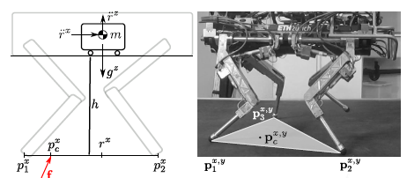
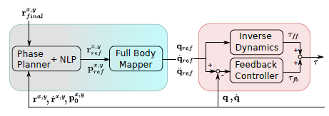
Continued...
Phase Planner that decides on the amount and sequence of steps (not their location)
NLP solver that produces a CoM motion plan and footholds
Full Body Mapper that maps the Cartesian output of the NLP to a full-body (base and joints) motion of the robot
Controller that generates the required torques to track the motion.

Slide 9
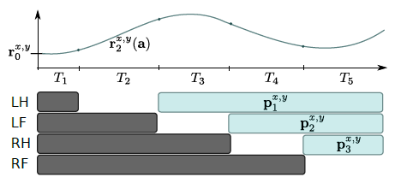
Continued...
Equations now explained from the paper

Slide 10
A bit discussion
Video - https://www.youtube.com/watch?v=EBW3lpr1tB8
By not fixing the footsteps beforehand, we allow the optimizer to modify the base of support as needed to perform the desired motion. This allows to perform the side-, diagonal- and backwards motions without any hand-tuned estimations of where to best place the feet.
In traditional approaches, the footsteps are decided by a footstep planner that for instance tries to keep the step length bounded or the footholds close to an estimated position of the CoM.
Fast online optimization of this framework makes it possible to be used in MPC fashion.

Slide 11
Further developments
Vertex based ZMP constraints.
We introduce a vertex based representation of the support-area constraint, which can treat arbitrarily oriented point-, line-, and area-contacts uniformly. This generalization allows us to create motions such as quadrupedal walking, trotting, bounding, pacing, combinations and transitions between these, limping, bipedal walking and push-recovery all with the same approach.
Gait and trajectory optimization
In this paper we replace the LIPM model with the 6D SRBD and the CoP with the 3D contact forces of each end-effector. This model allows reformulating concepts such as support-area constraints into unilateral contact forces, which can be more directly connected to underlying physical laws.

Slide 12
References
A. W. Winkler, F. Farshidian, M. Neunert, D. Pardo and J. Buchli, "Online walking motion and foothold optimization for quadruped locomotion," 2017 IEEE International Conference on Robotics and Automation (ICRA), 2017, pp. 5308-5313, doi: 10.1109/ICRA.2017.7989624.
A. W. Winkler, F. Farshidian, D. Pardo, M. Neunert and J. Buchli, "Fast Trajectory Optimization for Legged Robots Using Vertex-Based ZMP Constraints," in IEEE Robotics and Automation Letters, vol. 2, no. 4, pp. 2201-2208, Oct. 2017, doi: 10.1109/LRA.2017.2723931.
A. W. Winkler, C. D. Bellicoso, M. Hutter and J. Buchli, "Gait and Trajectory Optimization for Legged Systems Through Phase-Based End-Effector Parameterization," in IEEE Robotics and Automation Letters, vol. 3, no. 3, pp. 1560-1567, July 2018, doi: 10.1109/LRA.2018.2798285.
https://github.com/ethz-adrl/towr

Slide 13
Questions ??

